Slide 1


Slide 2

Brain Tumor Segmentation

Slide 3
Introduction
Name : Durr e Najaf
Student ID : bc200203321
Group ID : F2302554A1

Slide 4

INTRODUCTION OF PROJECT
Significance of image Processing:
Image processing involves manipulating digital images to extract valuable information or enhance specific features.
Application in healthcare:
It plays crucial role in medical image analysis, aiding in diagnosis, treatment and research, particularly in identifying brain tumor.

Slide 5
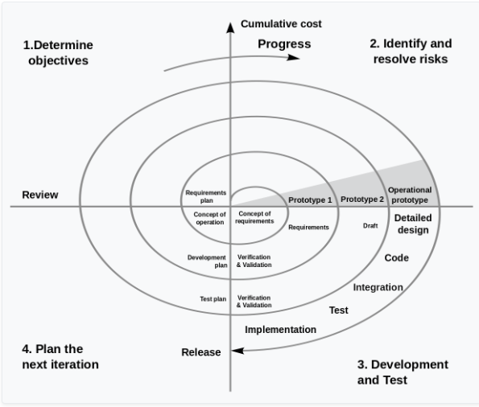
VU Process model

Slide 6
Reason to choose methodology
The VU process model is documentation driven model. It therefore complete and comprehensive documentation and hence makes the task maintenance task much easier because the feedback of the user must fulfill on each phase of development.
Vu process model is heavily depend on risk analysis and evaluation in each phase.
Progress tracking and risk management is easy in the process.

Slide 7
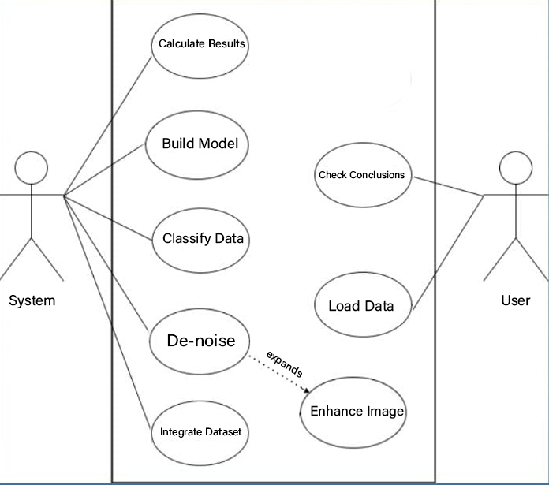
Use Case Diagram
Notes:
Behavior od the System.
Used to illustrate the functional requirements of the system and interacts with external agents (actor).
Gives high level view of the system without going into implementation system.

Slide 8
Functional Requirements
Data Collection and Preprocessing: Gather a diverse dataset of brain MRI scans, ensuring data quality and integrity. Preprocess the images to enhance their suitability for further analysis. Import the image dataset of Brain MRI scans from described link.
Dataset Splitting: To facilitate model training and evaluation, we will split the dataset into distinct sets for training, validation, and testing. This step ensures that the deep learning model's performance is rigorously assessed and prevents overfitting.
Deep Learning Model Development: We will design, implement, and fine-tune deep learning models, such U-Nets, to accurately segment brain tumors from MRI images.
Model Evaluation: We will establish robust evaluation metrics to assess the performance of the deep learning models, ensuring that the segmentation results are precise and reliable.
DataSet: For this project you need to use BraTs2019 Dataset.

Slide 9
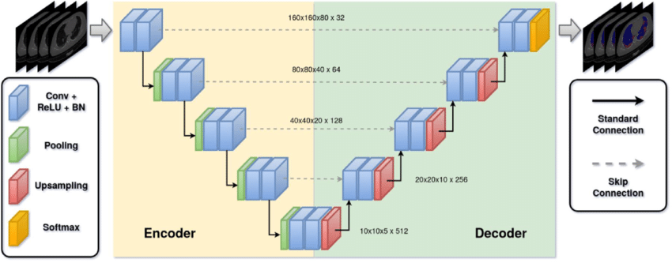
Architectural Design

Slide 10
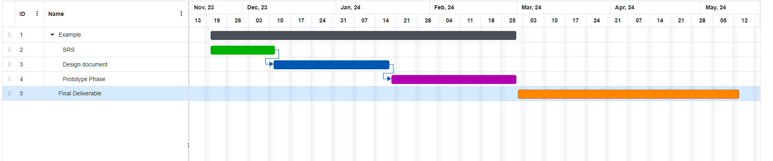
Project Schedule

Slide 11
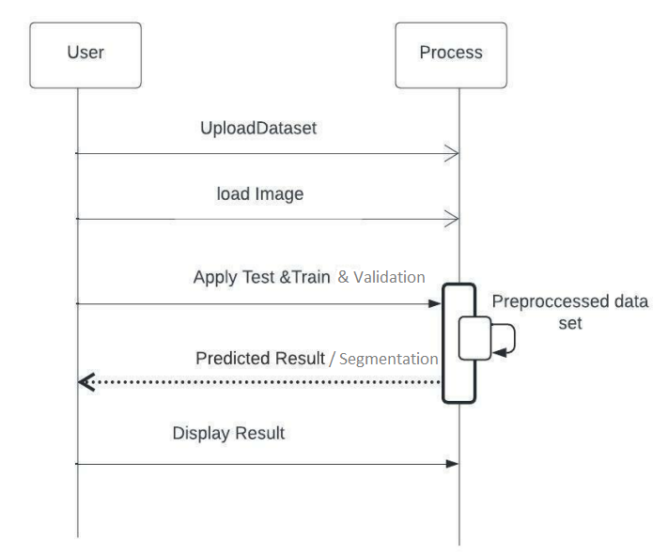
Sequence Diagrams
Notes:
Sequence diagram is under the term of behavior diagram.
Mentions the interaction b/w object and its response in timely order.
| activation line, User ()obj,

Slide 12
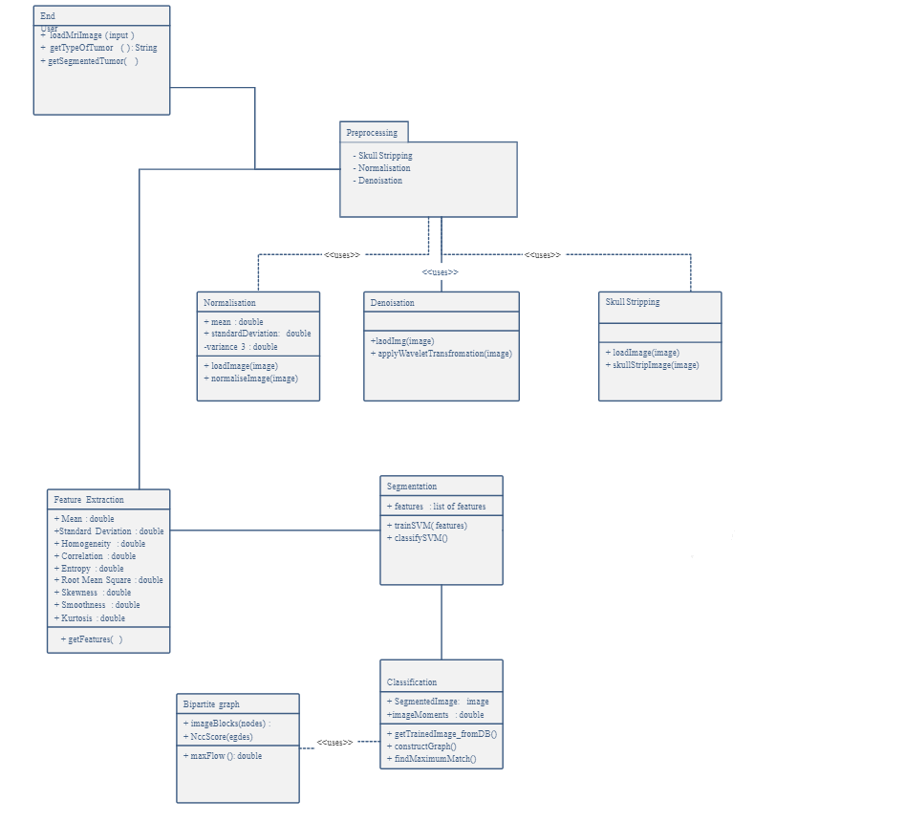
Logical Model/Class Diagram
Notes:
Static Diagram bcz we can’t change (e.g, car engine)
Obj blue print is known as class diagram

Slide 13
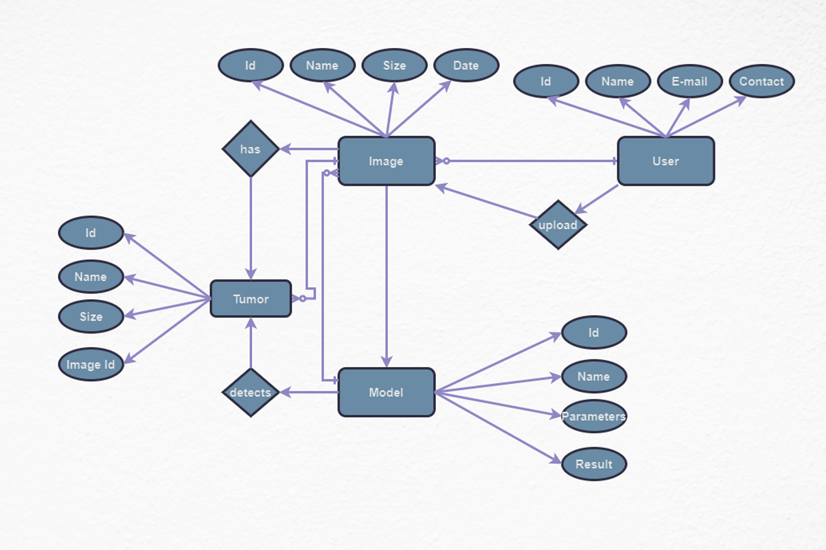
Entity-Relationship Diagram
Notes:
Over all logical structure of database can be expressed graphically using E-R diagram.
Entity, Weak entity, Attributes, derived attributes

Slide 14
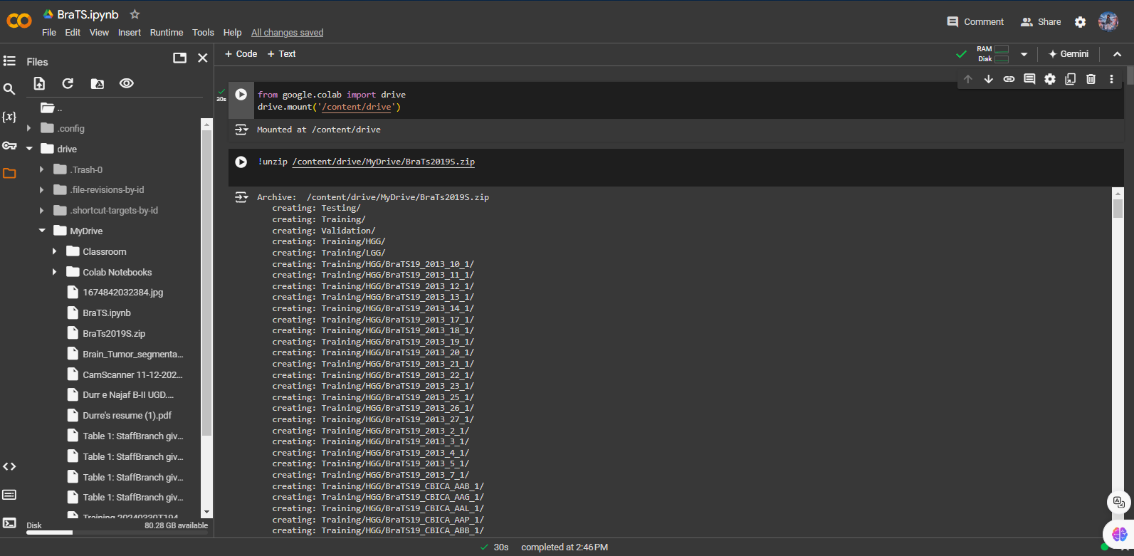
User Interfaces

Slide 15
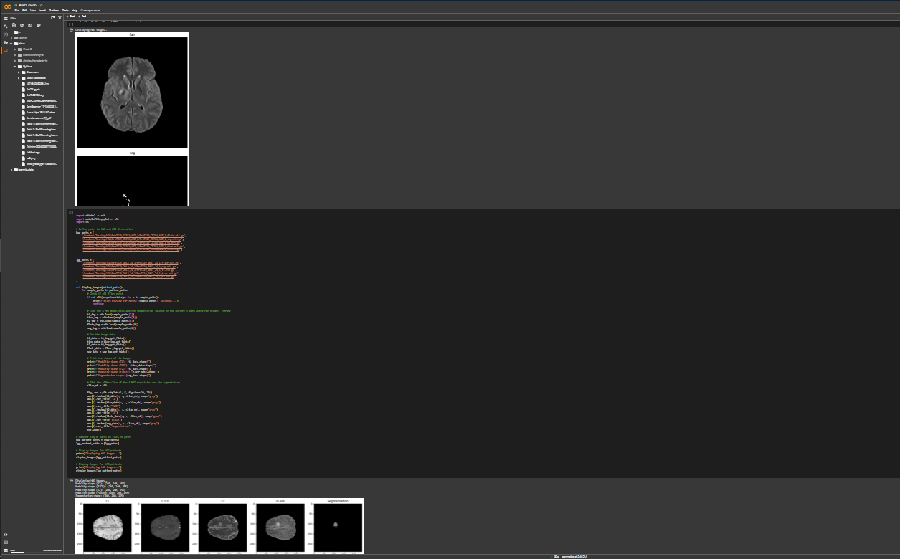
User Interfaces

Slide 16
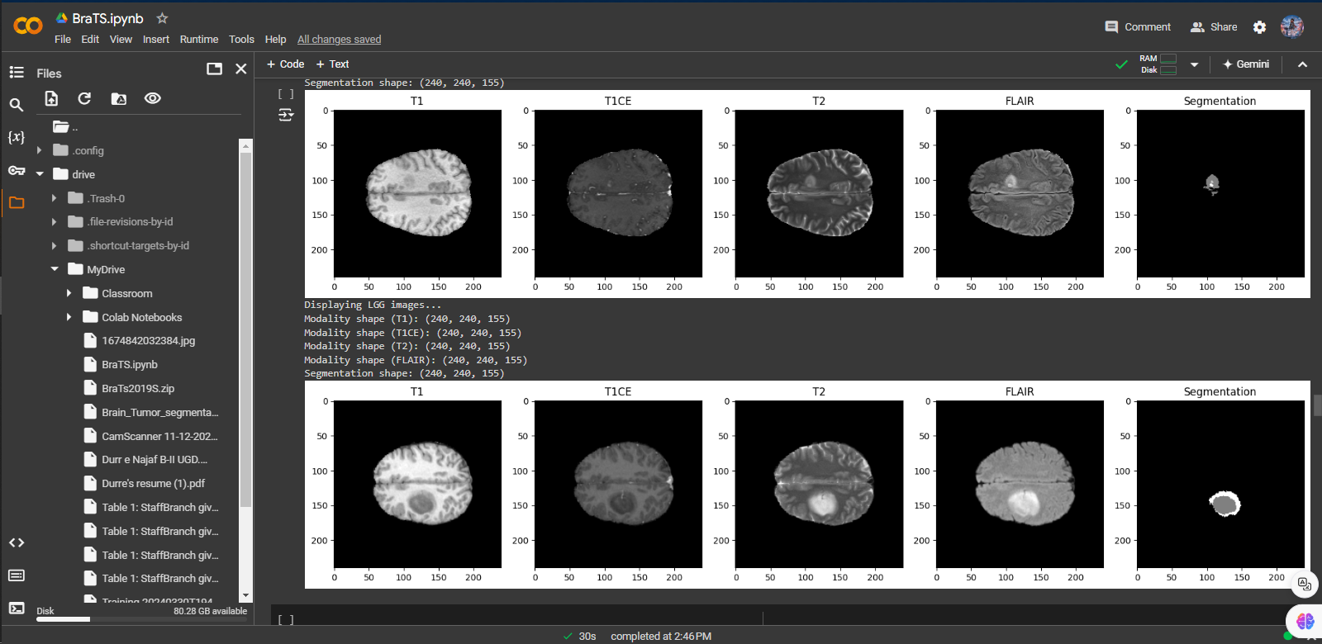
User Interfaces

Slide 17
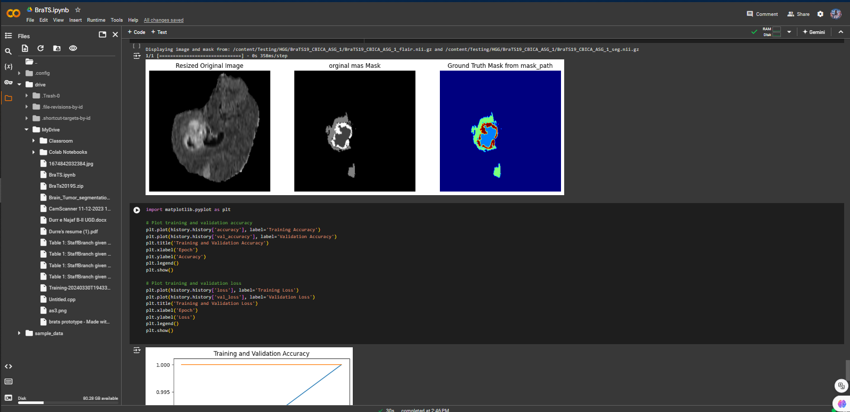
User Interfaces

Slide 18
Tools
Language: Python (Only python language)
Framework: Anaconda
IDE: Visual Studio Code, etc.

